Slide 1
Iteration statements

Slide 2
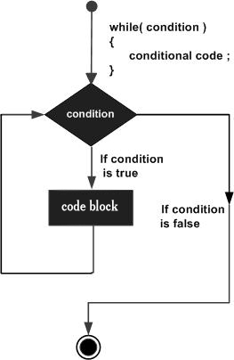
Loops
While loop
#include <stdio.h>
int main ()
{
int a = 10;
while( a < 20 )
{
printf("value of a: %d\n", a);
a++;
}
return 0;
}

Slide 3
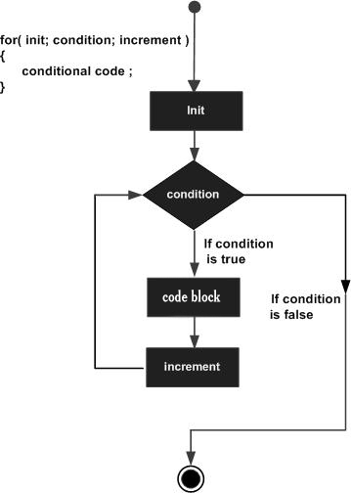
for loop
#include <stdio.h>
int main ()
{
int a;
for( a = 10; a < 20; a = a + 1 )
{
printf("value of a: %d\n", a);
}
return 0;
}

Slide 4
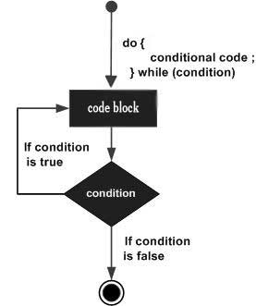
do...while loop
#include <stdio.h>
int main ()
{
int a = 10;
do
{
printf("value of a: %d\n", a);
a = a + 1;
} while( a < 20 );
return 0;
}

